Slide 1
Predicting Traffic Accident Severity
Applied Data Science Capstone Project
By Gaurav Tomar

Slide 2
Introduction:
Road accident has become one of the most cause of deaths in world. It is 8th leading cause of death in the world and estimated to become 7th leading cause by year 2030. It's time when we should analyze the factor that are causing road accident and we can ensure to take precautionary measures to minimize the road accident in coming days.

Slide 3
Data:
All the records accidents in France from [2005 to 2016].
Initial dataset from the kaggle from here
The features of the datasets:
In the characteristics dataset, We'll keep the following features , "lighting", "localization"(agg), "type of intersection", "atmospheric conditions", "type of collisions", "department", "address", "time" and the coordinates. We added two new features from this original dataset, "date" and "weekend" indicating if the accident occurred during the weekend or not.
In the places dataset, we'll keep the following features: "road categorie", "traffic regime", "number of traffic lanes", "road profile", "road shape", "surface condition", "situation", "school nearby" and "infrastructure".
We have created the following features from the user datasets:
num_us : total number of users involved in the accident. ped : Wether there are pedestrians involved or not. critic_age : If there is any user in between 17 and 31 y.o. sev : maximum gravity suffered by any user involved in the accident: 0 = Unscathered or Light injury 1 = Hospitalized wonded or Death I used the holiday dataset to craft a new feature indicating the accident accurred during a holiday.

Slide 4
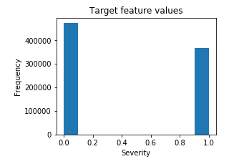
EDA:
The target feature a binary classifier, describing the accident severity.
0: low severity
1: high severity, from hospitalized wounded injury to death.
It is balanced labelled dataset with more cases of lower severity.

Slide 5
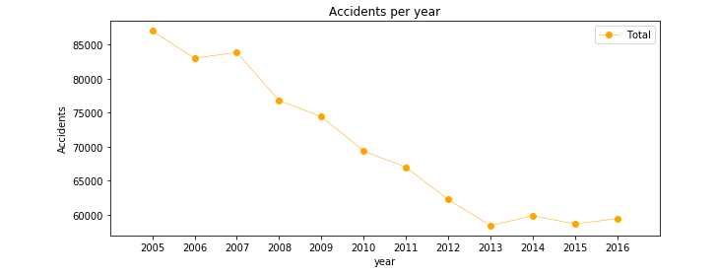
Accidents per year

Slide 6
Classification models:
Random Forest:
10 decision trees
Maximum depth of 12 features
Logistic regression:
c = 0.001
KNN:
K=16
SVM:
Due to computation inefficiency, training size was reduced to 75000 samples.

Slide 7
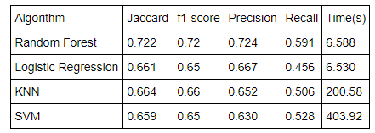
Results:

